Slide 1
Session 2 – Abstraction and Testing Data Skills for Research Kellogg Research Support
August 14, 2023

Slide 2
Three Lessons
Declarative > Procedural
Modular > Monolithic
Automatic > Manual
Notes:
All these things turn procedural unspoken knowledge into explicit, declarative and executable specifications

Slide 3
Roadmap
Declarative Practices
Specify your environment
Use code, not your mouse
Use source control
Modules
Structure code into functions
Group functions into files
Automating Code Execution
Write automatic tests
Turn your code into executable scripts
Notes:
All these things turn procedural unspoken knowledge into explicit, declarative and executable specifications

Slide 4
1. Declarative Practices
Declarative > Procedural
Modular > Monolithic
Automatic > Manual
Notes:
All these things turn procedural unspoken knowledge into explicit, declarative and executable specifications

Slide 5

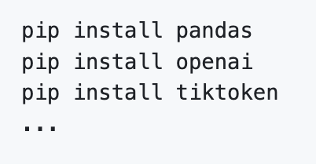
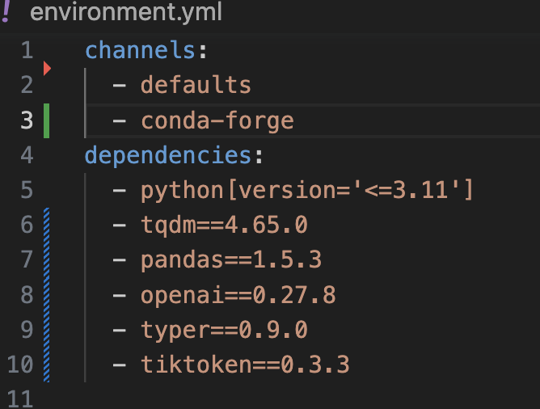
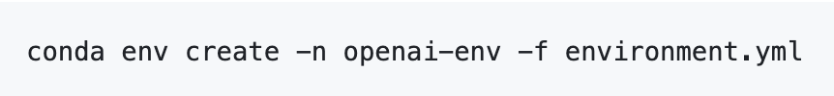
Specify Environments
Notes:
Demo conda on KLC

Slide 6

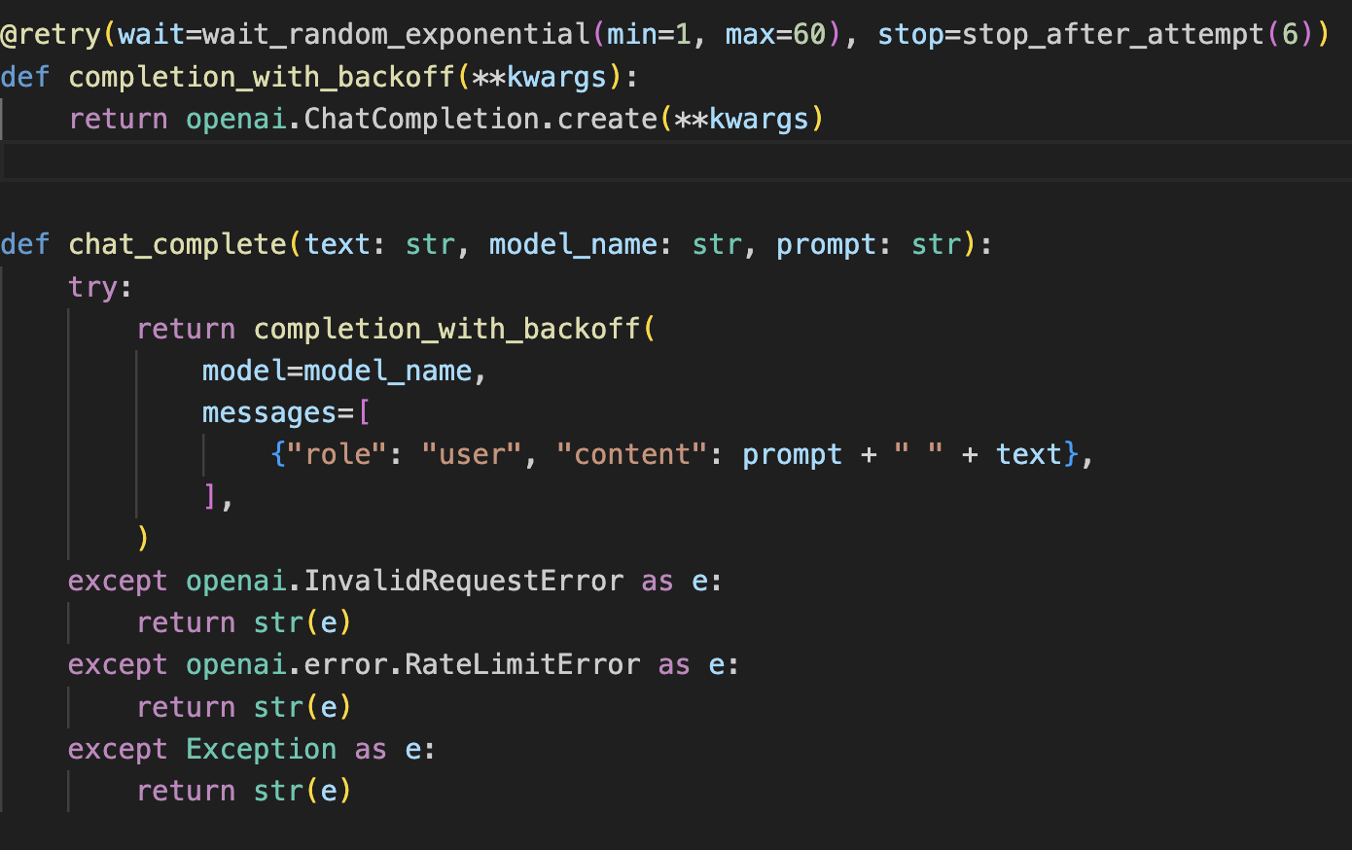
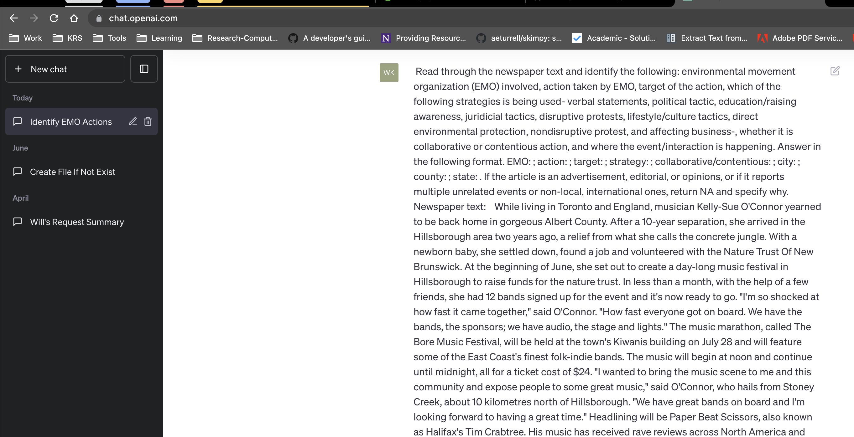
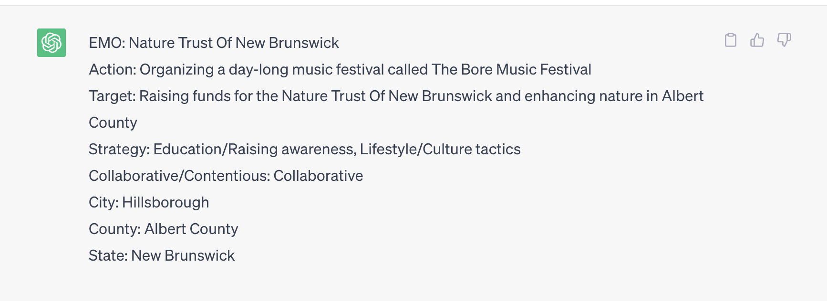
Code vs. Mouse

Slide 7
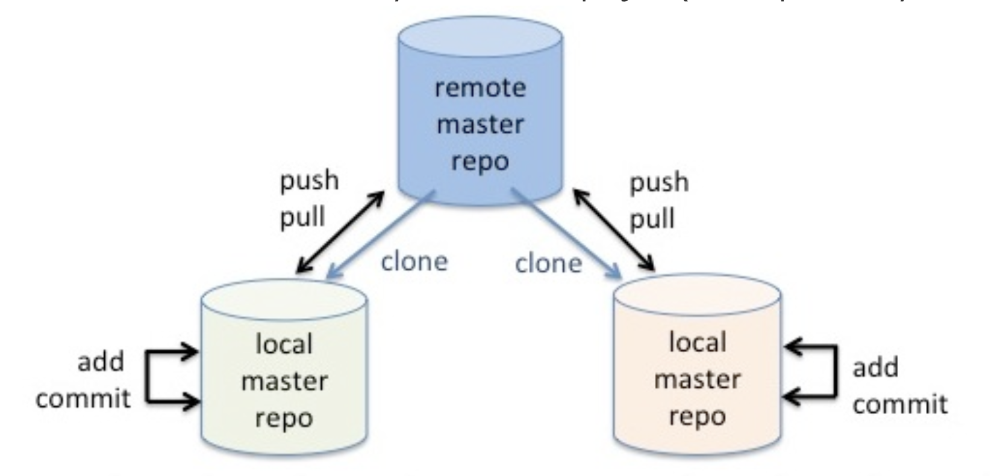
Source Control
Notes:
Demo github, clone onto laptop, KLC

Slide 8
2. Modularity
Declarative > Procedural
Modular > Monolithic
Automatic > Manual
Notes:
All these things turn procedural unspoken knowledge into explicit, declarative and executable specifications

Slide 9

Abstract Code into Modules
Modularity: breaking code down into manageable, configurable, cohesive, and maintainable chunks

Slide 10
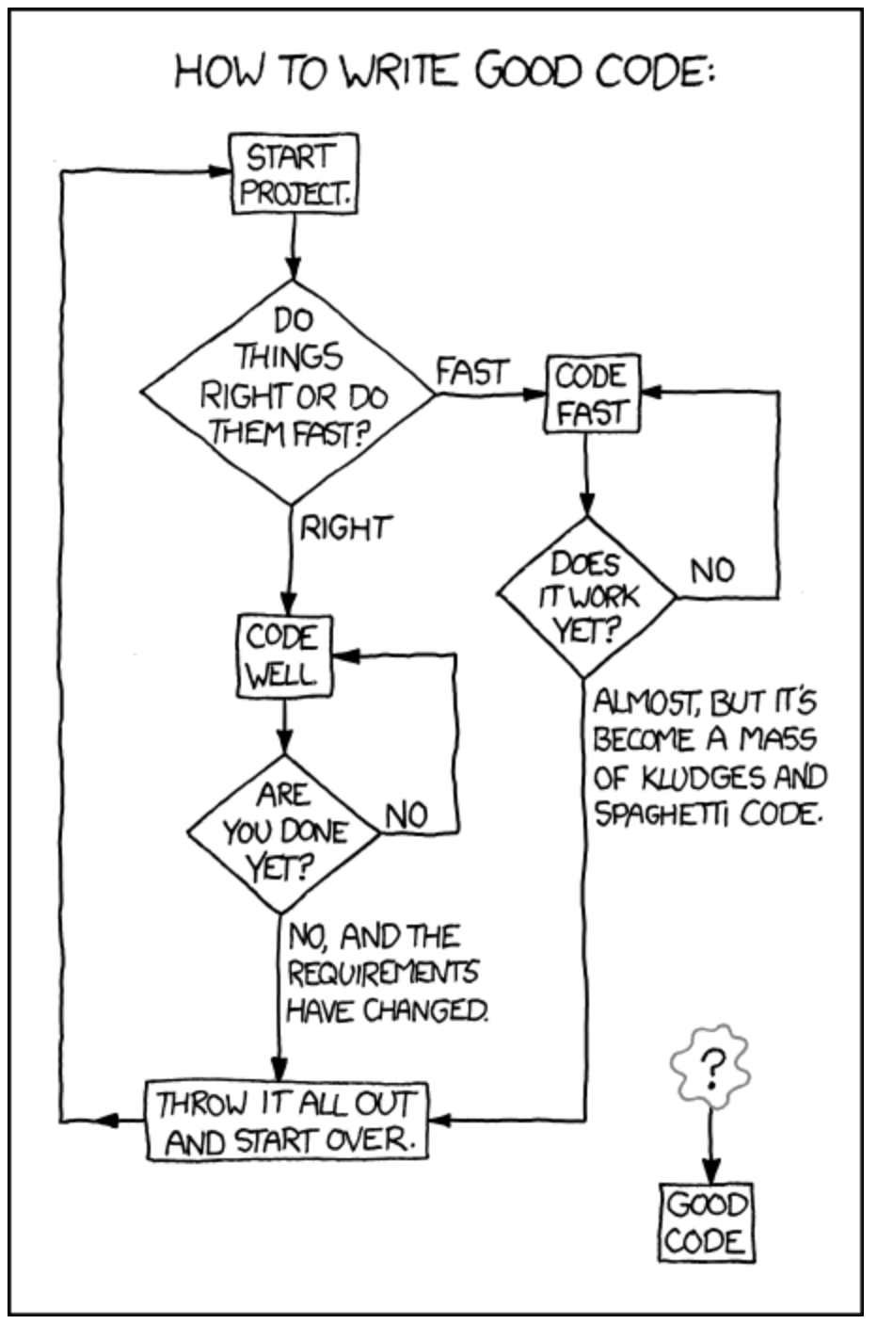


Benefits of Modules
Easier to understand
Easier to test for correctness
Easier to change and update
Combinatorial goodness

Slide 11
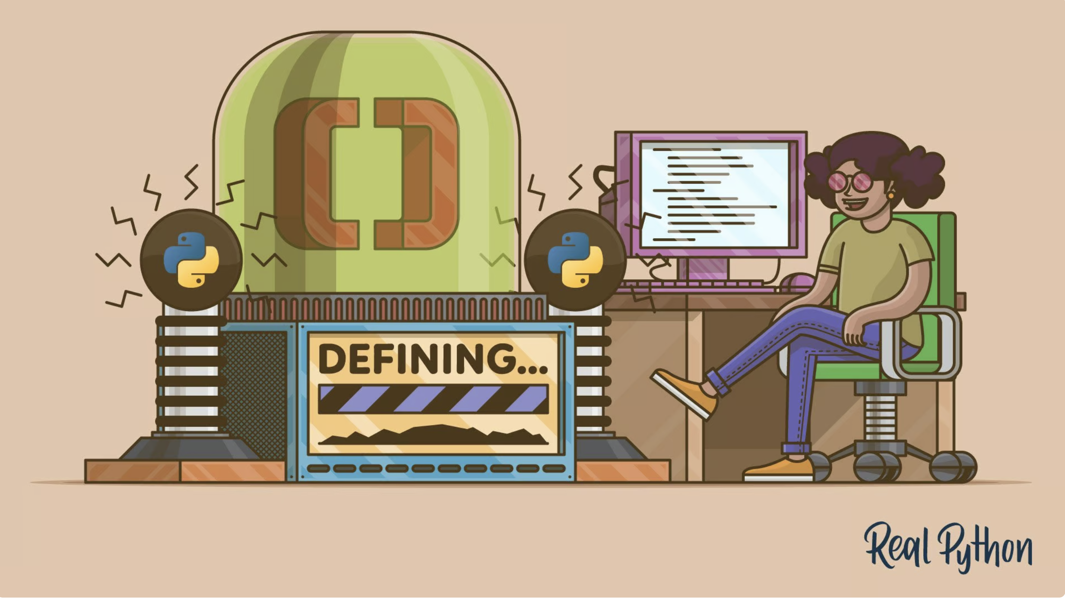
Functions as Modules
The basic way to organize code is into functions and groups of functions
Functions can be included in core language
Functions can be added through 3rd party libraries
Functions can be also be user defined

Slide 12
Guidance for Defining Functions
Functions should extract logic into a single source of truth
Each function should do only one thing – keep it simple
Organize functions into groups (files, packages)
Test function inputs with assertion statements
Test function with unit tests

Slide 13
Repetitive Code
// Load the "nlswork" dataset (if not already loaded)
use https://www.stata-press.com/data/r17/nlswork.dta
// Subset the dataset for the year 1976
keep if year == 76
// Run fixed effects regression for the year 1976
xtreg wage, fe
estout, title("Fixed Effects Reg by Year 1976") cells(b(star fmt(%9.3f)) se(fmt(%9.3f))) replace
// Subset the dataset for the year 1978
use https://www.stata-press.com/data/r17/nlswork.dta, clear
keep if year == 78
// Run fixed effects regression for the year 1978
xtreg wage, fe
estout, title("Fixed Effects Reg by Year 1978") cells(b(star fmt(%9.3f)) se(fmt(%9.3f))) replace

Slide 14

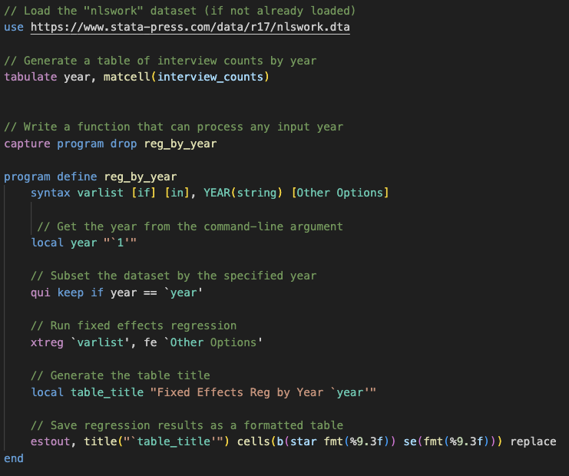
Abstract a Function

Slide 15
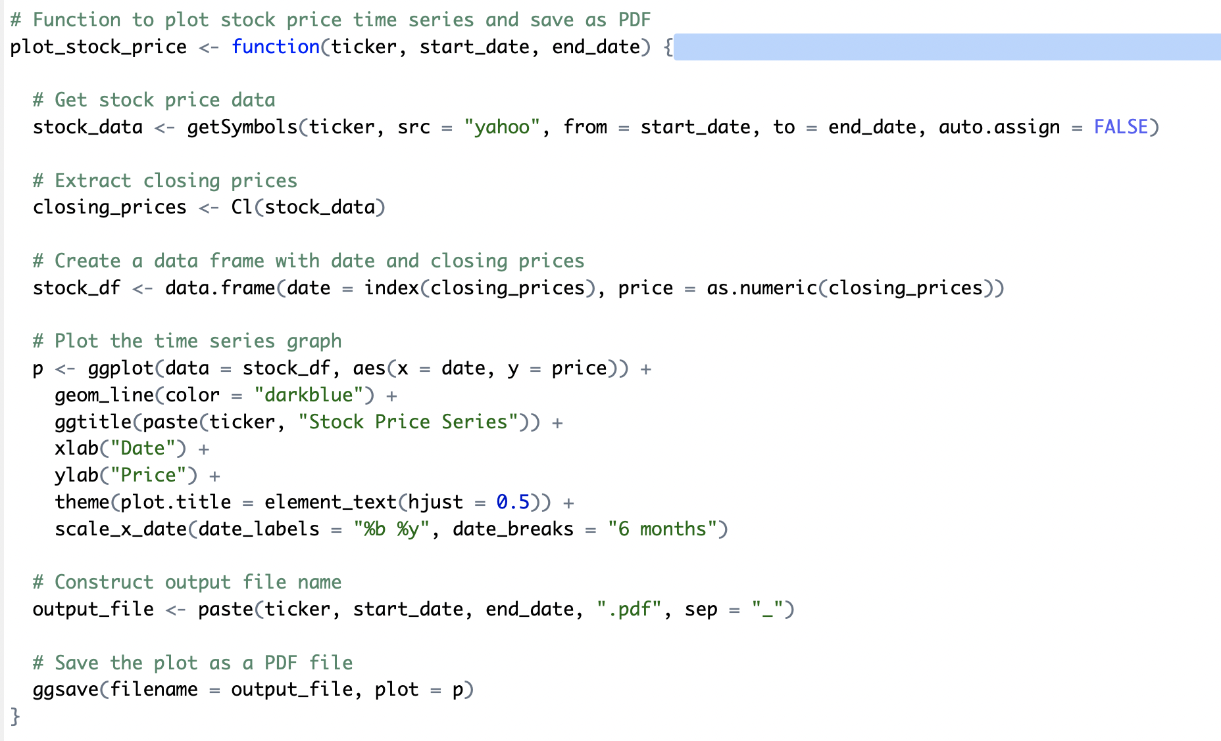
Do Everything Functions

Slide 16
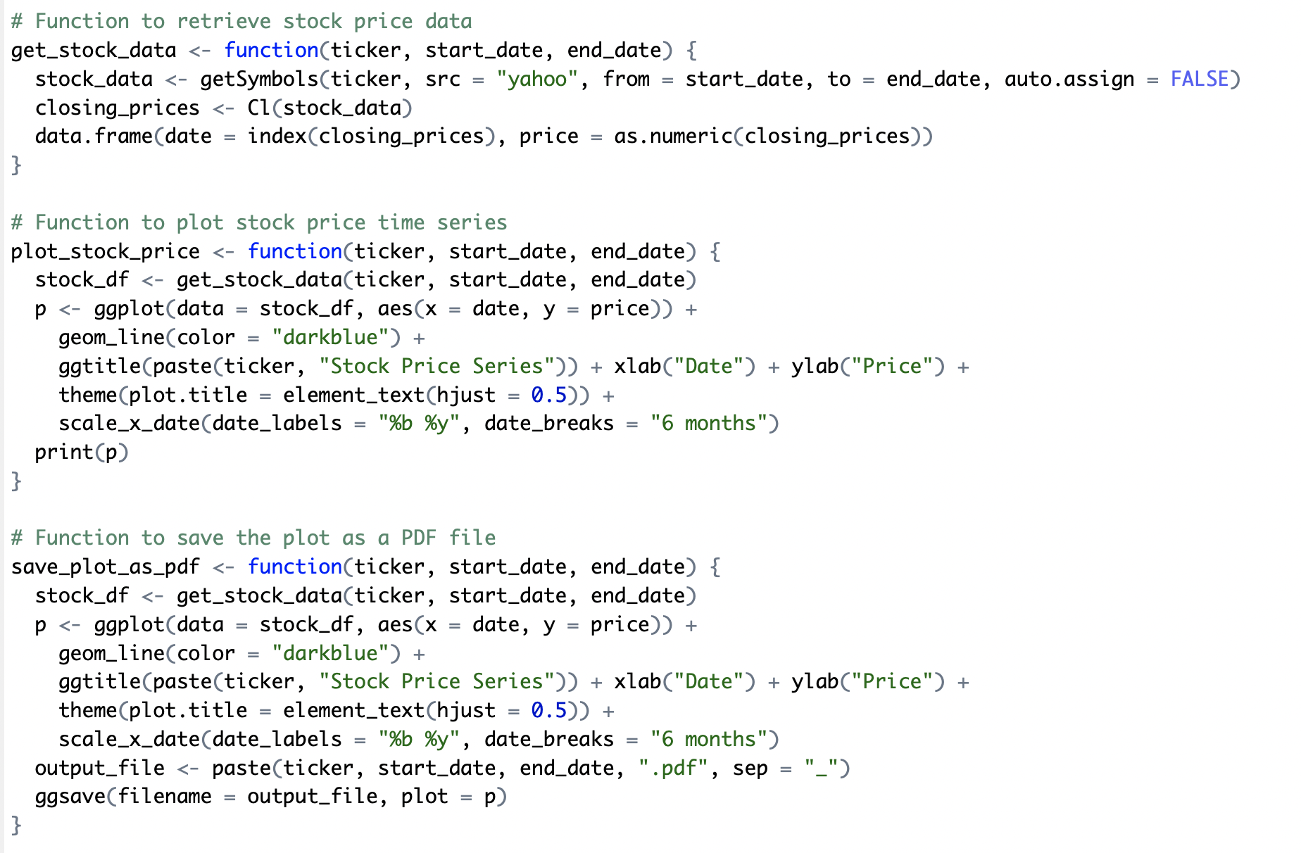
Modular Functions

Slide 17
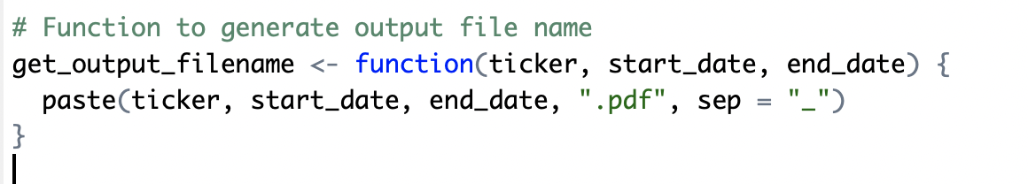
Functions should be useful!
Caveat: a function can be too simple to be worth the trouble:
Prompt: what could we add to make such a function worthwhile?

Slide 18
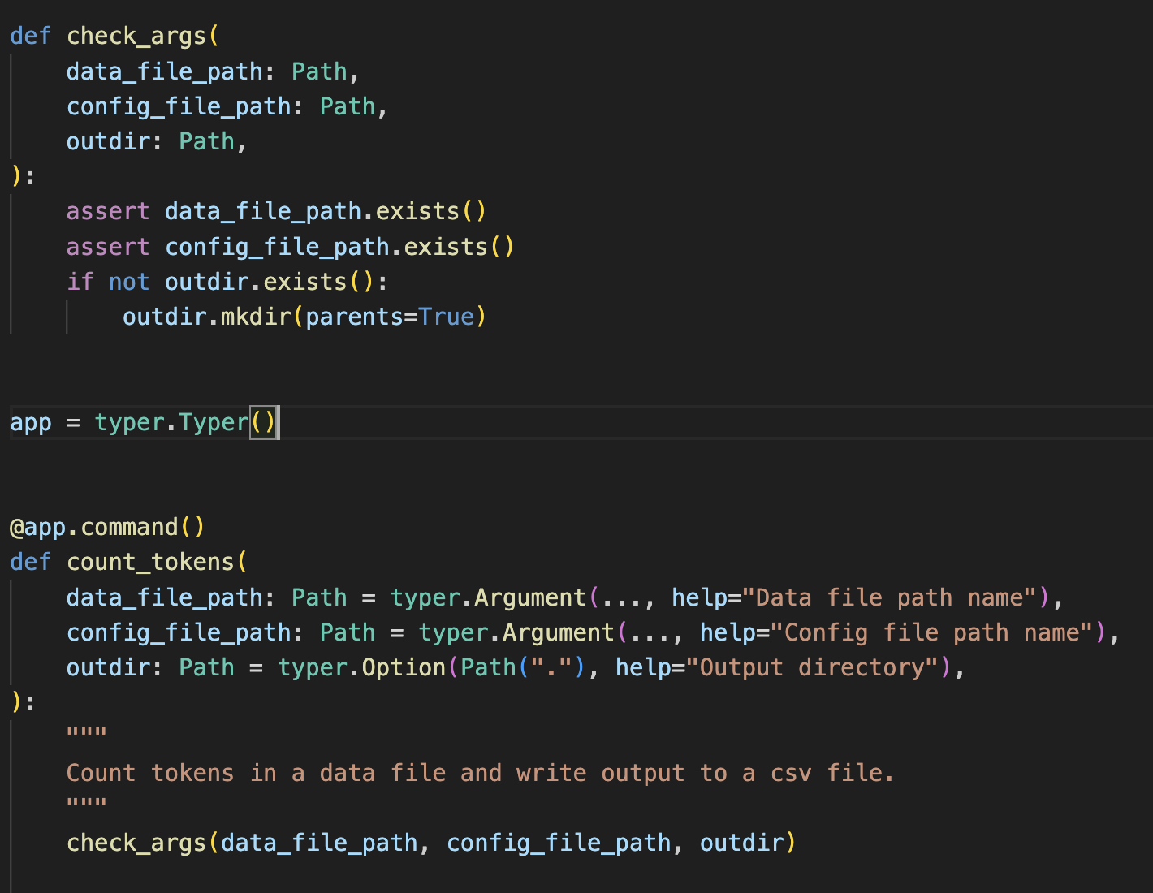
Validate Function Inputs

Slide 19
3. Automation
Declarative > Procedural
Modular > Monolithic
Automatic > Manual
Notes:
All these things turn procedural unspoken knowledge into explicit, declarative and executable specifications

Slide 20
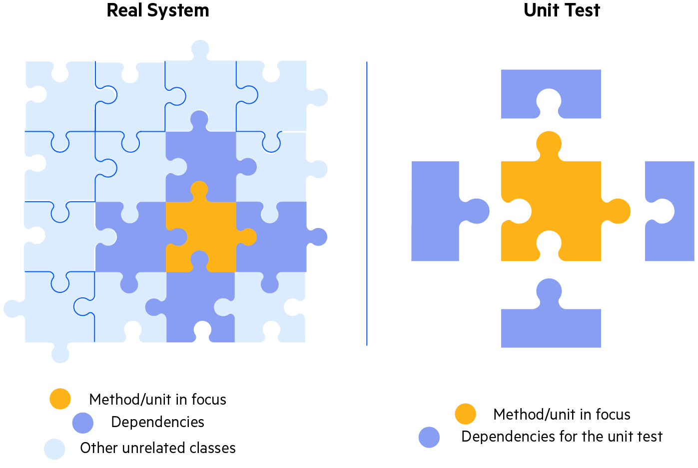
Automated Tests
Unit Tests :
The goal of unit testing is to test a single “unit” of the code in isolation.
For instance, execute a single function with a range of inputs and validate the corresponding outputs

Slide 21
Unit Tests
Proper unit testing is automatic, not manual
Each unit test has three parts:
setup input
activate code, and
assert result
Best to write code and tests at the same time!
Assertions around testing… does this file exist.
Notes:
Show code

Slide 22
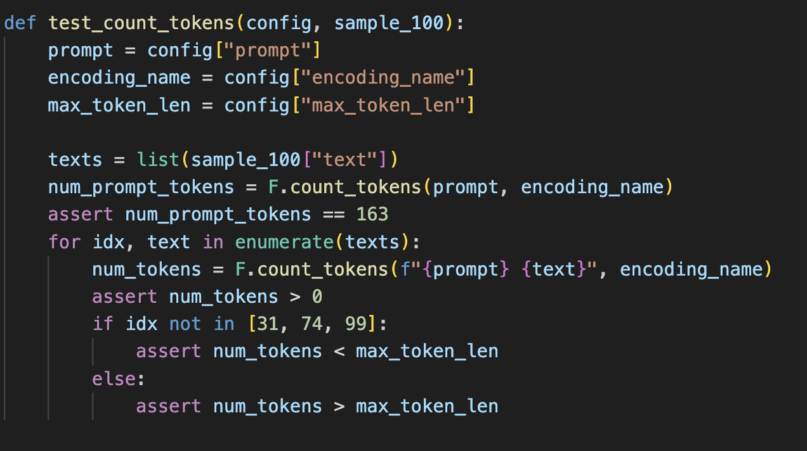
Python Example

Slide 23
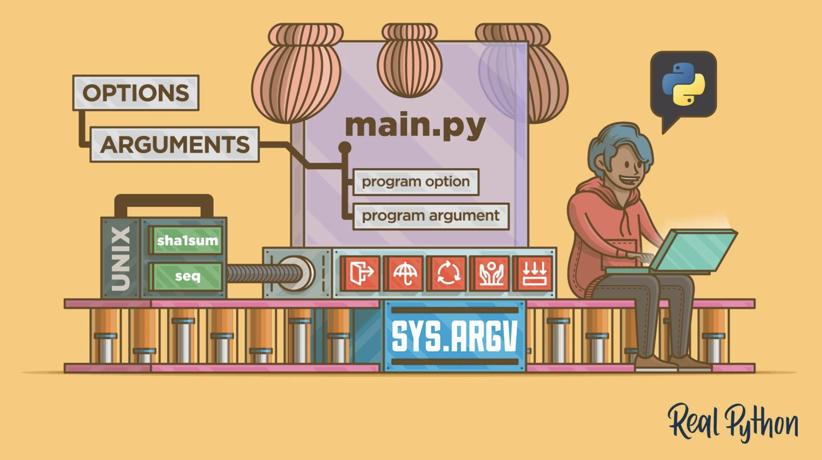
Command Line Interfaces

Slide 24
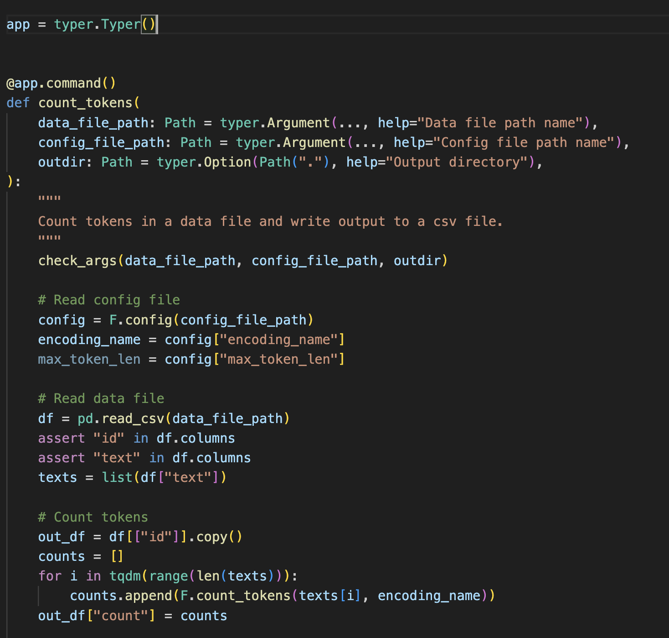
Example: CLI for Python
Notes:
Run example

Slide 25
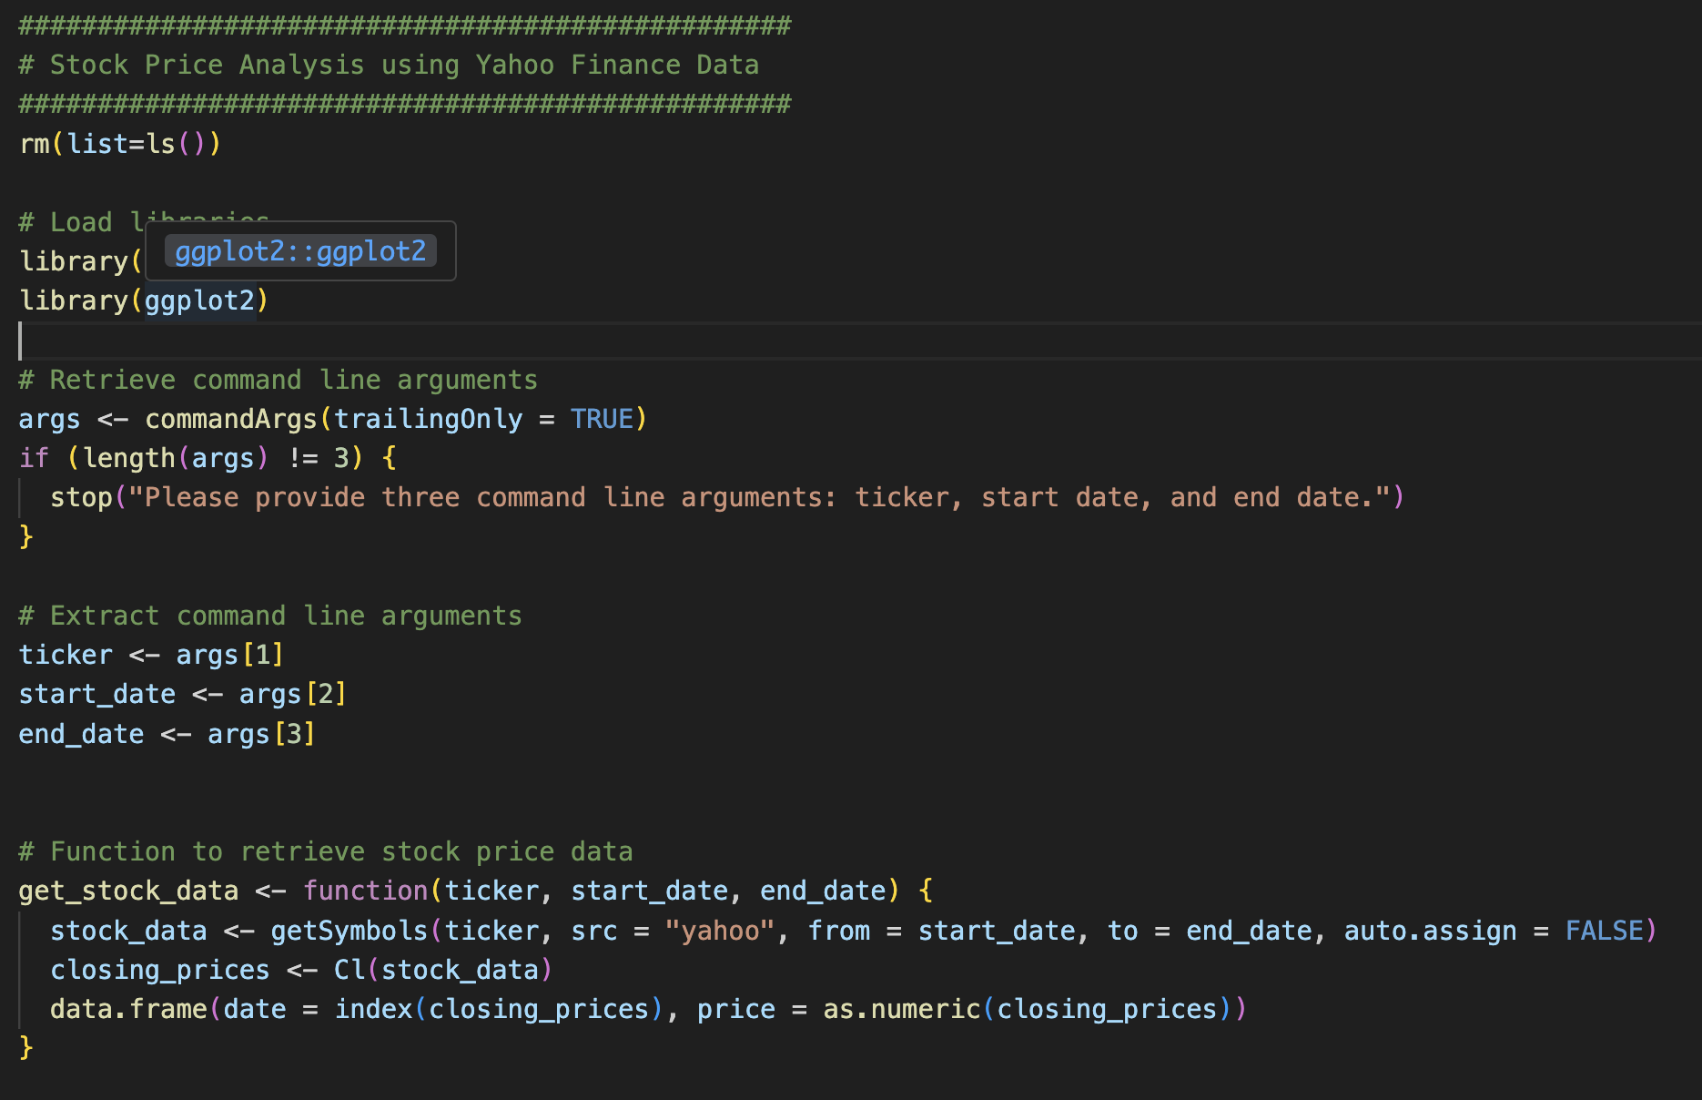
Example: CLI for R

Slide 26
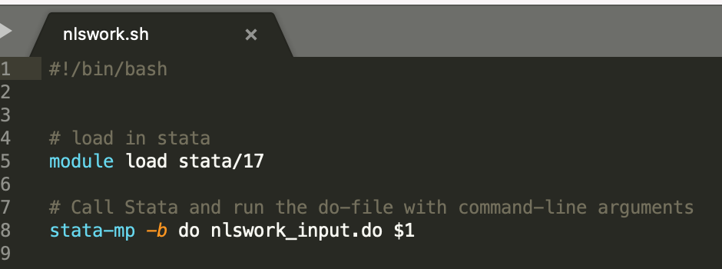
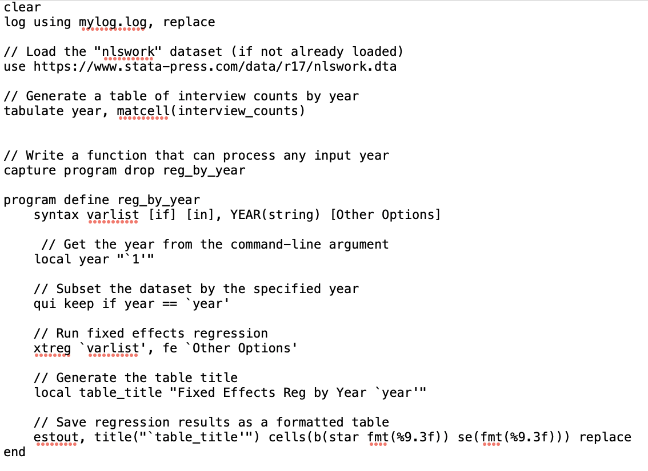
Example: CLI for Stata
nlswork_input.do

Slide 27
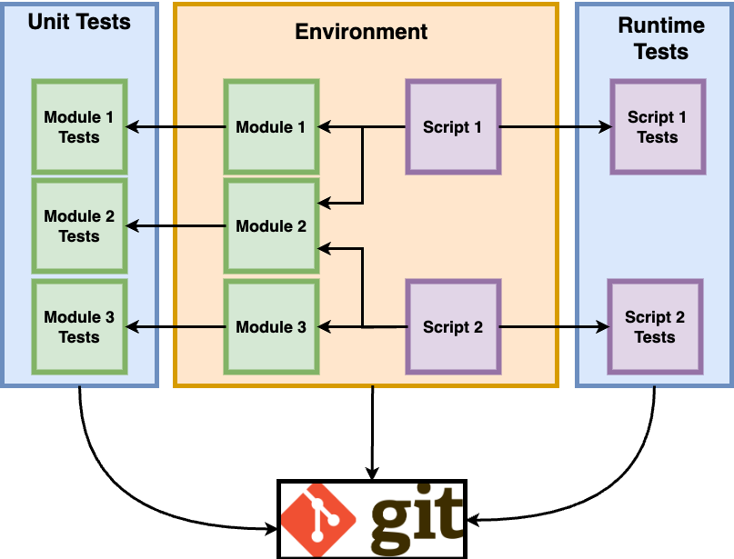
Conclusion: Big Picture
Version Control

